Slide 1
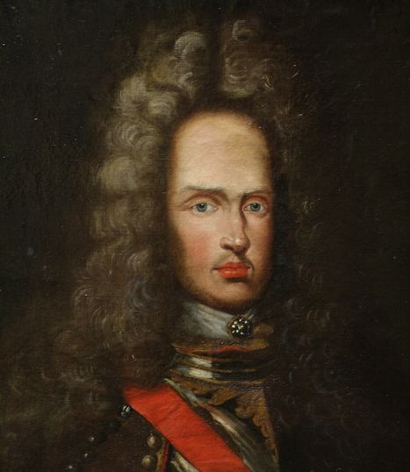
criterios art collection
Portrait of Joseph Ist, Holy Roman Emperor
(1705-1711)

Slide 2
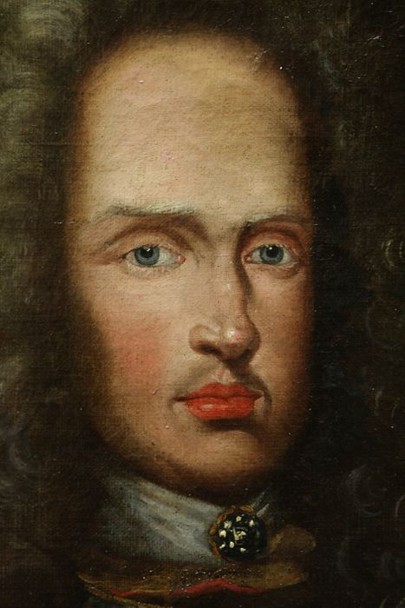
The criterios portrait presents great physical similarities with the Portrait of Emperor Joseph I (1678–1711), 1700 belonging to the Princely Collections of Liechtenstein.
[Oil on canvas height 92 cm, width 74 cm, Gallery frame with original oval cut-out, German, 1st quarter of 18th century, Inv.-No. GE1589]
Link

Slide 3
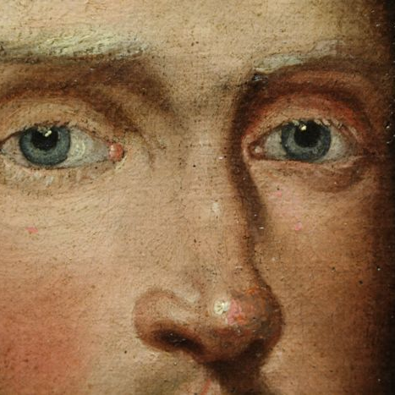
A later portrait of the Emperor currently in Trieste, Castello Di Miramare (Castle), painted by Josef Kiss and Friedrich Mayrhofer shows quite identical facial characteristics.

Slide 4
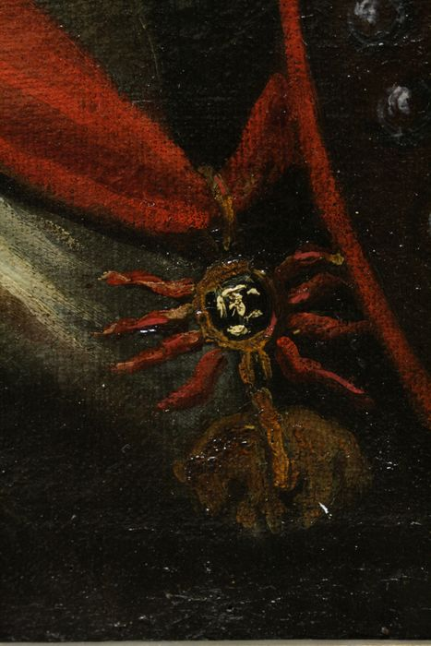
As in any Habsburg family member portrait, Joseph is holding the Order or the Golden Fleece necklace.
Criterios Portrait
Trieste Portrait
Liechtenstein Portrait

Slide 5
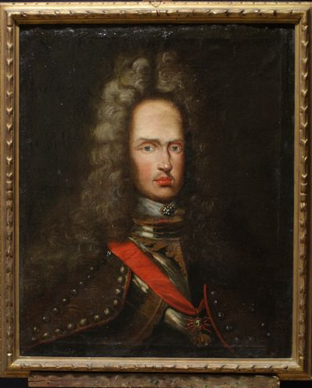
Criterios Portrait
Trieste Portrait
Liechtenstein Portrait

